Slide 1
Firearm injuries I
Dr I. Kitulwatte

Slide 2
Objectives
To understand the mechanism of causation of missile injury
To understand the causation of injury with regards to velocity of the weapon.
To know the 2 basic types of firearms and there features and differences

Slide 3
Objectives cont--
To know the factors determining the firearm injuries
To identify different features of rifle wounds at different ranges.
To know the features of bullet wounds in bones
To know the features of firearm exit wounds
To know the wounding mechanisms of shot guns at different ranges.

Slide 4
Fire arm injuries
The injuries are caused by a missile or projectile discharged by a firearm.

Slide 5
Mechanism of missile injury
To cause damage
Needs absorption of some or all of the kinetic energy
Transfer of energy is based on:
The resistance of the tissue.
In a soft tissue, absorption is minimal (apart from the bullet tract)
May not be fatal unless a vital organ is affected.

Slide 6
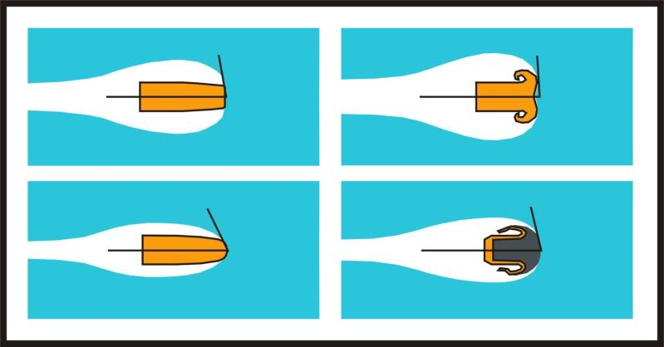
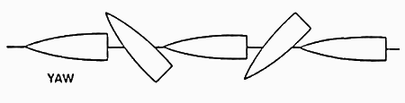
2. Make of the bullet
Bullets are modified:
Soft headed bullets –flatten on impact
Air cavity within the tip- splay open on impact
2. Trajectory or course of the bullet
Tumble end over end
Bullet yaw along axis

Slide 7
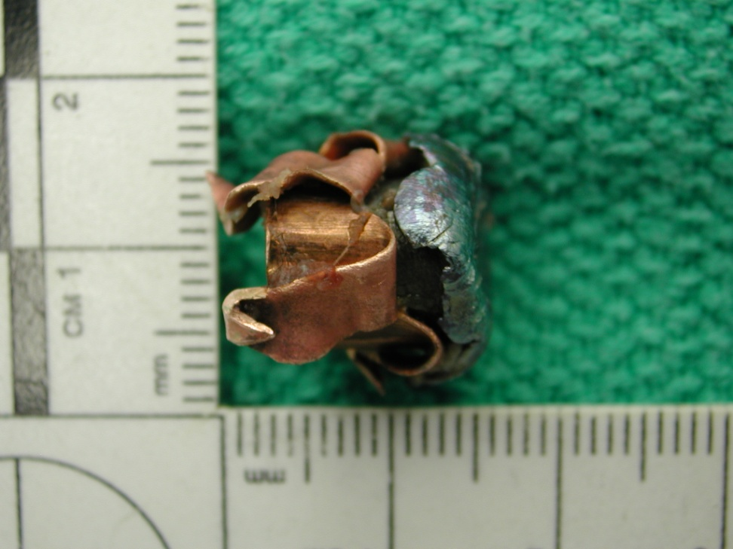
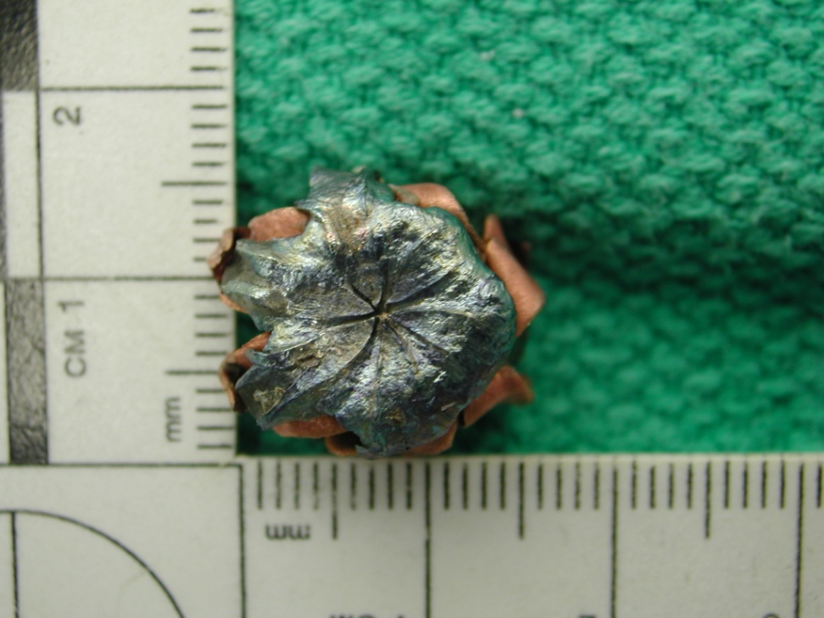
Soft headed bullet

Slide 8
3. Velocity of the bullet
Low velocity - 1100 feet/second
(tissue damage is limited )
High velocity – 4800 feet/second
(rises the tissue pressure to extreme (temporary cavitation)

Slide 9
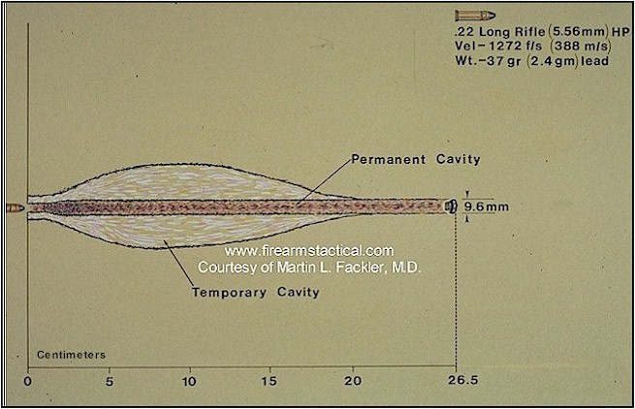
High velocity bullet effect

Slide 10
Types of firearms
The nature of the wound varies with the type of the weapon.
2 main types:
Shot guns or smooth bore weapons
Rifled weapons.

Slide 11
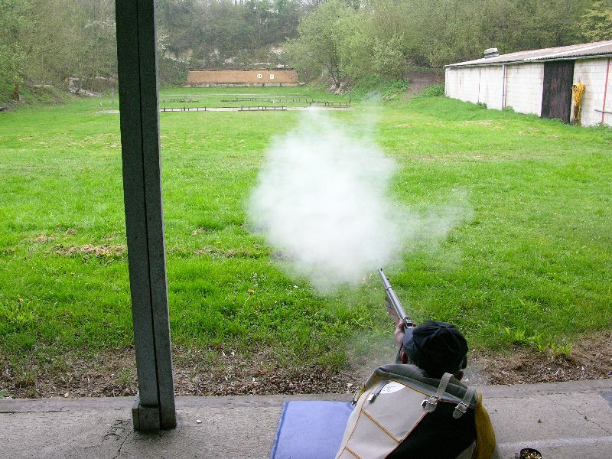
RIFLE SHOOTING

Slide 12
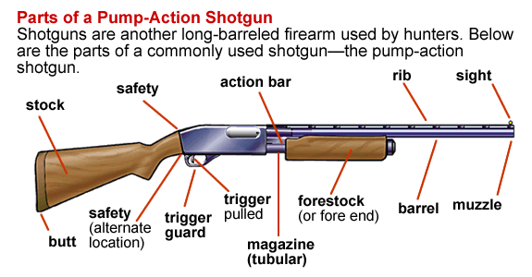
Shot guns or smooth bore weapons

Slide 13
Smooth bore weapon
1 or more metal barrels
Relatively wide diameter
Smooth inner surface
Slightly tapers towards the muscle (choking)
Variable number of pellets
Large number of pellets (bird shot)
Few large projectiles (Buck shot)
Single slug

Slide 14
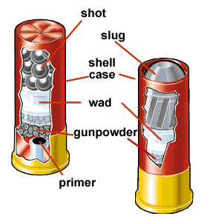
Ammunition
Cartridge: cardboard or plastic cylinder with a metal base
Contain from bottom to top:
Charge of propellant (gun powder)
Wad (cardboard or plastic discs)
Pellets
Modern devices are improved to increase efficiency

Slide 15
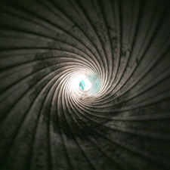
Rifled weapons
Fire 1 projectile at a time
A thicker barrel with spiral groves (rifling of the interior)
Gives rotatory movement to bullet
Increases the stability

Slide 16
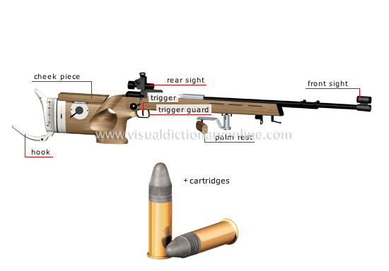
Rifled weapons

Slide 17
There are many varieties
Hand guns (revolvers and automatic pistols)
low velocity
Rifles – long barreled,
velocity varies from 1500 feet -5000 feet /second
Submachine guns (machine pistols)
more powered than pistol but less powered than rifle
Machine guns- design to fire rifle bullets in quick succession

Slide 18
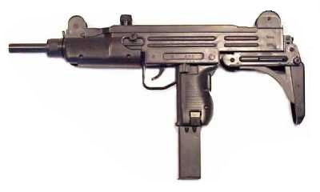

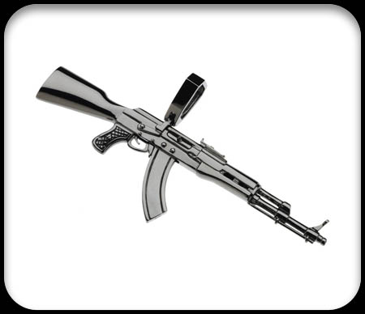
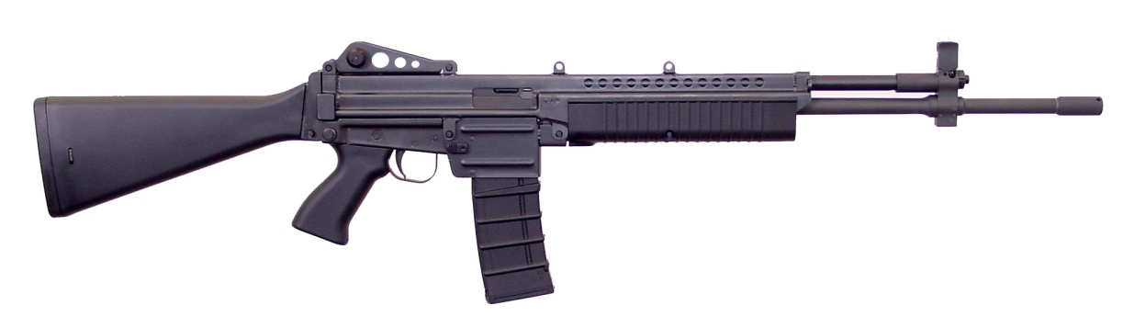
Various types of rifled firearms
Submachine gun
handgun
Rifle
Machine gun

Slide 19
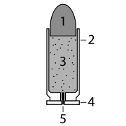
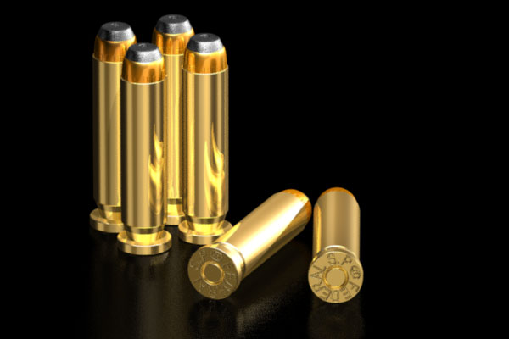
Ammunitions
Basically the design is:
Bullet, a lead core covered in a steel/nickel jacket is firmly clamped into the open end
Shell /cartridge /casing (metal cylinder closed at one end)
Inside the shell loaded with explosive propellant
Rim – part of casing used for loading
Primer – which ignite the propellant

Slide 20
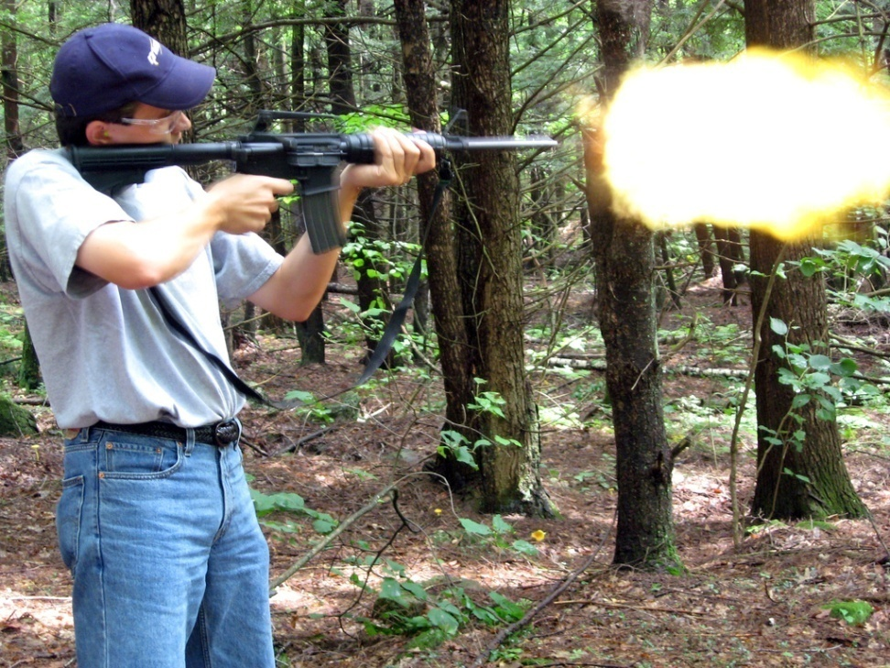
The mechanism of action:
Once detonated produce large volumes of hot gases under pressure
Expel the bullet

Slide 21
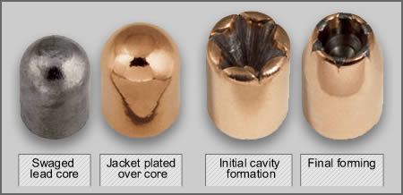
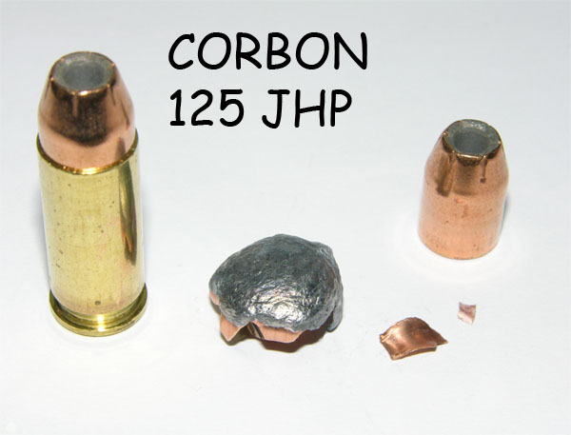
Bullet

Slide 22
Fire arm injuries
The nature of the injuries is affected by:
Type of weapon (shot gun/rifle)
Velocity of the weapon
The nature of the projectile
The nature of propellant
Degree of choke (if any)
The range of discharge
Angle of discharge

Slide 23
Penetrating and perforating injuries
Penetrating trauma
object does not pass through
perforating injury
object enters and passes all the way through

Slide 24
Firearm damage to internal organs
In low velocity missiles
Lacerations
Contusions
Complete mechanical disruption (in mass of shot guns and gas strikes, and low velocity rifle bullets)

Slide 25
In high velocity missiles
Disproportionate damage relative to diameter
Due to cavitation effect
Specially in solid organs

Slide 26
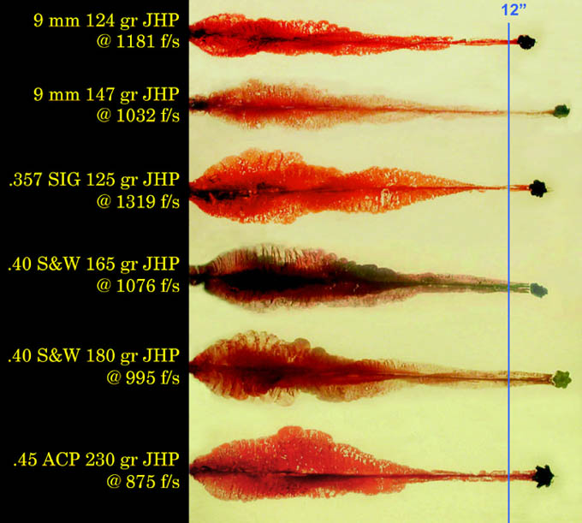
Cavitation effect in different handguns

Slide 27
How to describe a gunshot/ Firearm wound?
Gunshot wound of xxx perforating penetrating :
Entrance:
Path of bullet:
Exit or
Site of lodgment:
Direction in body:
Comment:

Slide 28
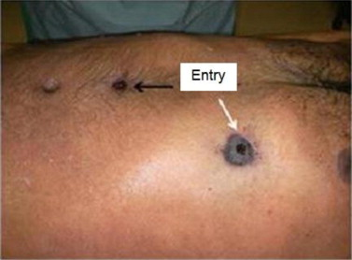
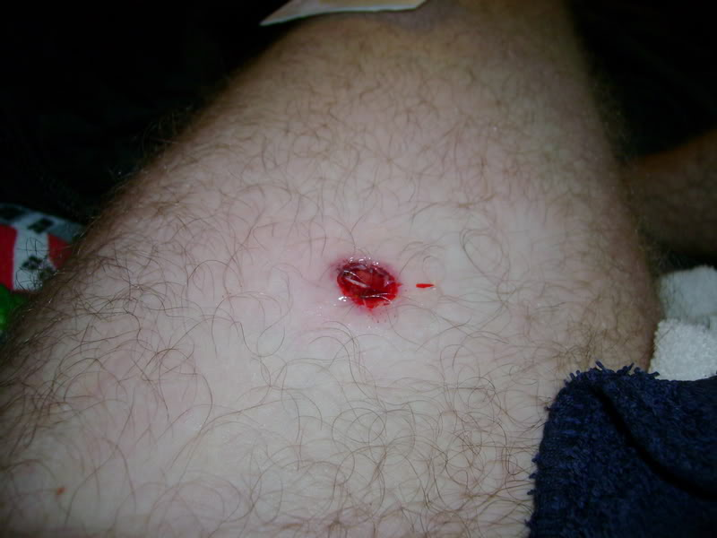
Entrance:
Anatomical site:
Position: xxx cm from the top of the head and xxx cm xxx to the midline plane
Size: ~ xxx cm
Marginal abrasion: Concentric, eccentric (xxx)
Marginal effects: No blackening (xxx); stippling (xxx)
Special features:
Pathological range:

Slide 29
Path of bullet:
Wound path: Entrance wound → xxx → xxx→ xxx → xxx→ xxx → xxx
Hemorrhage:

Slide 30
Exit:
Anatomical site:
Position:
Size: ~ xxx cm
Shape, margin:

Slide 31
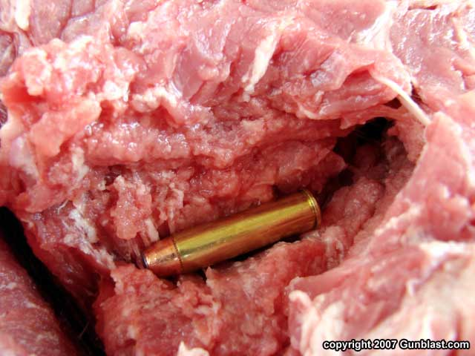
Site of lodgment:
Anatomical site:
Position:
Projectile:

Slide 32
Rifled weapon injuries
Depending on the velocity of the projectile wound characteristics vary.
Common features
Usually single bullet from one discharge (unless defect in the weapon firing 2 at once)
Automatic weapons may show multiple wounds in close succession

Slide 33
Features due to
Bullet
Flame
Gases eliminated
Soot
Burnt and un burnt gun powder
Muzzle mark (in close range)

Slide 34
Contact rifled weapon injuries
Wound small and circular unless on a bony surface
Over bony support can split to form a cruciate/ stellate wound
Burning and blackening of the immediate wound edges (if the contact is lose)

Slide 35
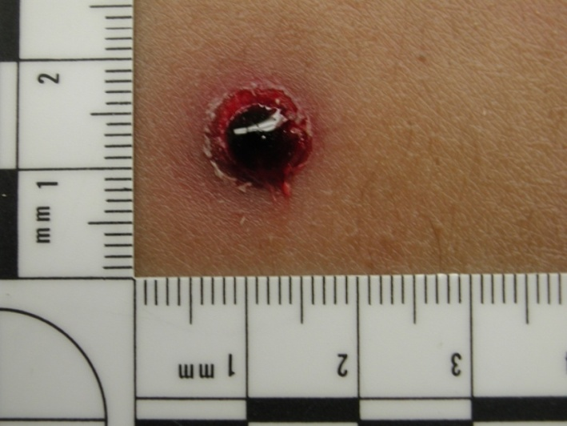
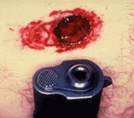
Contact rifled weapon injuries cont--
Soot deposition within the wound
Areola of hyperaemia - extend beyond muzzle imprint
Cherry pink discolouration due to CO.
Muzzle imprint
There may be complex imprints due to foresights and mechanisms for self loading automatics

Slide 36
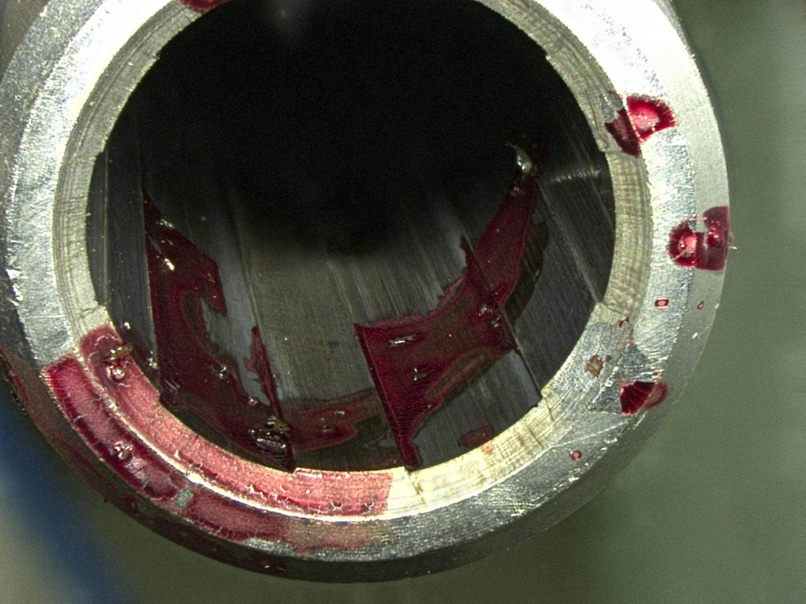
Back spatter or blow back in to barrel
Contact and close range discharge can result in entering of blood and tissue fragments in to the muzzle.
Due to the momentary suction effect as pressure of gas blast diminishes.

Slide 37
Close range rifle wounds
Circular in shape.
Margins of the wound -inverted but sometimes due to rebounding gases may be everted
Abrasion collar around the margin
Due to the inversion of the skin with the entry of missile causing the bullet to wipe the epidermis
Caused by friction and heat

Slide 38
Close range rifle wounds
Burning within a few cm. with hair singeing
Hyperaemia around the wound
Most propellant used now are clean however there may be blackening
Powder tattooing around the vicinity (distribution helpful in determining the direction)
Fouling (tiny lesions around the entry wound caused by fragments of metal expressed)

Slide 39
Intermediate or distant range wounds
No difference
Circular central hole with inverted margins (usually smaller than bullet )
Abrasion collar around the central hole

Slide 40
Intermediate or distant range wounds cont--
Grease ring- inner edge of the abrasion collar may be black (heating and dirt)
There may be bruising around the wound
No burning, blackening or tattooing around

Slide 41
In extreme distance:
Reduced velocity of the bullet
Bullet begin to wobble and yaw or even tumble (turn end over end)
If the bullet strikes the body sideways- rectangular wound mimicking a laceration

Slide 42
Direction of discharge
In close range rifle injuries shelving or undercutting are useful-indicates angle entry
Burning, blackening and tattooing are less evident and therefore of little help

Slide 43
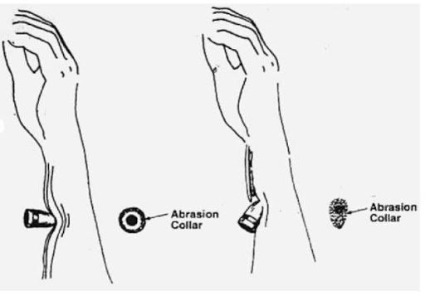
Direction of discharge cont--
Shape of the abrasion collar-
More useful
Asymmetrical in angle entry
Join the trajectory between entrance and exit(unless bullet diverted within)
Consider posture of the victim

Slide 44
Exit wounds of rifled weapon
Many are perforating
Again the velocity of the bullet is a determining factor
High velocity often pass through-

Slide 45
If an intact bullet emerges:
Exit wound is a small everted defect (classically stellate could be slit like or linear)
There is no abrasion collar
No burning, blackening or tattooing

Slide 46
Exception to usual exit
If emerges against supported skin (tight garments, floor/wall) a circular exit wound
This is called a shored exit
Has an abrasion collar as well
Difficult to differentiate from an entrance
(specially in distance and intermediate range)

Slide 47
When the bullet is deformed or emerged side ways
Exit can be of any size or shape
May be multiple (if fragmented/pieces of bones also exit)

Slide 48
Re-entry
Penetration of 2 parts of the body
Commonly through and through wound of the limb re-entering the chest/abdomen

Slide 49
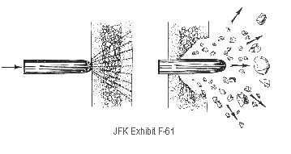
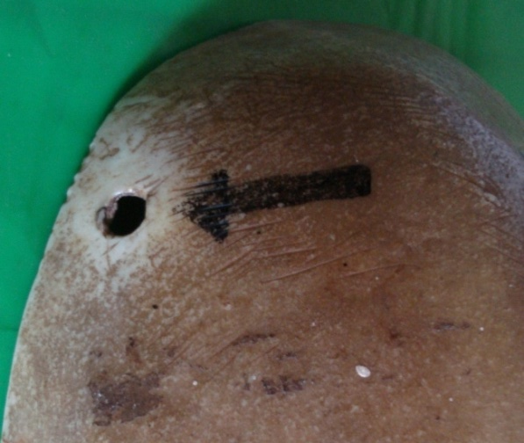
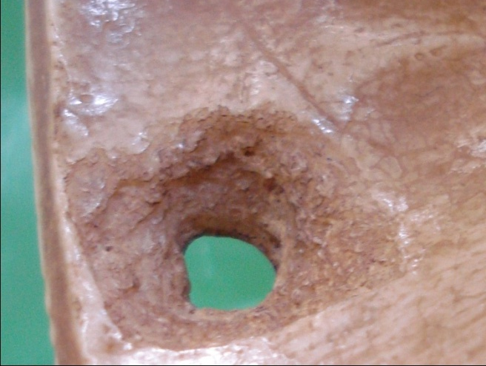
Bullet wound in bones
In a thin bone like cranium, sternum or pelvis - beveling
Initial contact punches a clean hole in outer table.
When emerges internally causes a crater that is larger than the external hole

Slide 50
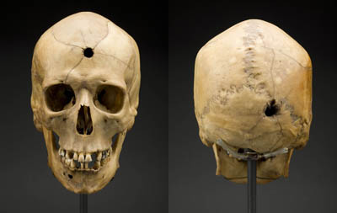
Bullet wound in bones cont--
Same pattern occurs when bullet exists the cranium
In addition there are fissured or comminuted fractures
Thicker bones - comminuted fractures and bony fragments
can acquire a velocity causing secondary injuries.

Slide 51
Key hole wounds
A missile striking the skull tangentially produces a keyhole defect
Here the entrance and exit defects overlap
One end of the perforation - inner beveling , while the other end - external beveling

Slide 52
Glancing rifled wounds
Can occur when bullet enters in an angle.
Can have a superficial course
Damage may be little
In irregular surfaces can have several re-entries and exits
May follow skull/rib curvatures without entering through

Slide 53
Summary
Kinetic energy of the missile determines the extent of damage.
Energy transfer is based on tissue resistance, and course and velocity of the bullet
Damage from the low velocity missiles is limited only to the bullet tract while in high velocity missiles severe disruption within a wide zone around the bullet track is seen.

Slide 54
Summary cont--
There are 2 basic types of firearms rifle, and shot gun.
Shotgun fires a variable number of pellets.
Rifle fires 1 projectile (Bullet) at a time which has a rotatory movement due to the grooves in the barrel.
Entrance, path of bullet, exit/site of lodgment are the key areas in describing a gunshot wound.

Slide 55
Summary cont--
Rifle bullet entry wounds are usually small and circular with abrasion collar.
Burning, blackening and tattooing are seen in contact and close range firearm injuries.
Presence of a muzzle imprint indicates contact firearm injury.
Inner or outer beveling of the skull are determining factors for entry or exit wounds.
Exit wounds are not common in shot guns while they are commonly irregular or slit like in rifled firearms.

Slide 56

Thank you!

